Slide 1
Machine Learning Classification
Assigment documendation

Slide 2
Problem Statement or Requirement:
A requirement from the Hospital, Management asked us to create a predictive model which will predict the Chronic Kidney Disease (CKD) based on the several parameters. The Client has provided the dataset of the same.
1.) Identify your problem statement:
Given dataset has Numerical value, So, it comes under the Machine Learning.
Given input and output data is very clear. So, It comes under the Supervised learning.
Given output is like yess or no type . So, It is comes under the Classification.
The client is asking to predict the chronic kidney diease, by given datast.This AI model name is CKD-prediction

Slide 3
2.) Tell basic info about the dataset (Total number of rows, columns)
Rows : 399 & Column : 28
3.) Mention the pre-processing method if you’re doing any (like converting string to number – nominal data)
In the given dataset some columns are not used so we are going to remove than and also some string also there in the dataset set ,its like ordinal data so we are going to use the labe parameters to convert that strig to numers

Slide 4
4.Develop a good model with good evaluation metric. You can use any machine learning algorithm; you can create many models. Finally, you have to come up with final model
I have created the AI models by using the machine learning algorithms like Support Vector classification, Decision Tree classification, Random Forest classification. Logistic regression ,KNN and NAVIE BAYES
I have usd gridsearchCV and standardscaler for the best module creation , I got in best accuracyin randomforest classification.so I took this module as my best brain.i attached everything below

Slide 5
5.) All the research values of each algorithm should be documented. (You can make tabulation or screenshot of the results.)

Slide 6
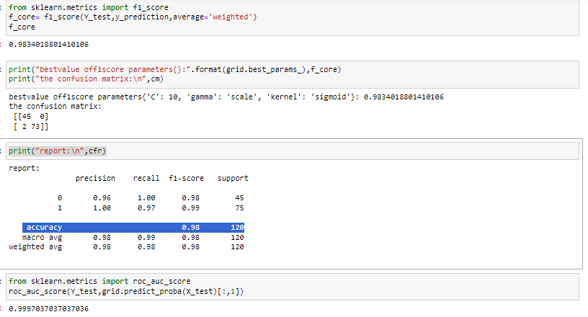
SVC

Slide 7
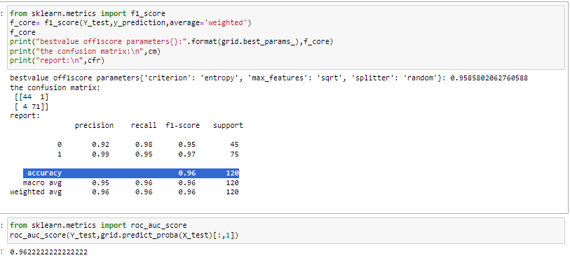
DTC

Slide 8
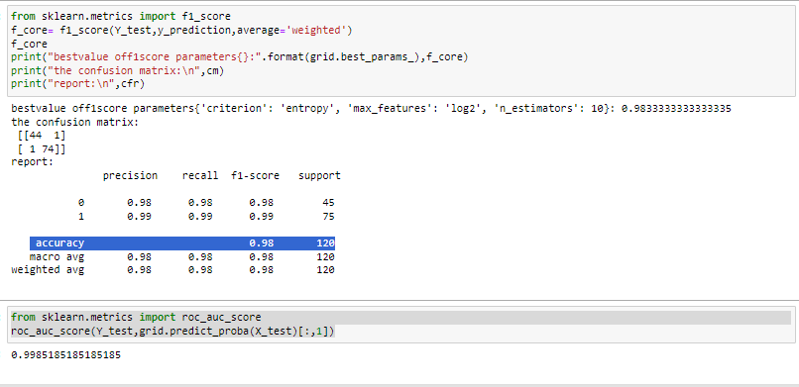
RFC

Slide 9
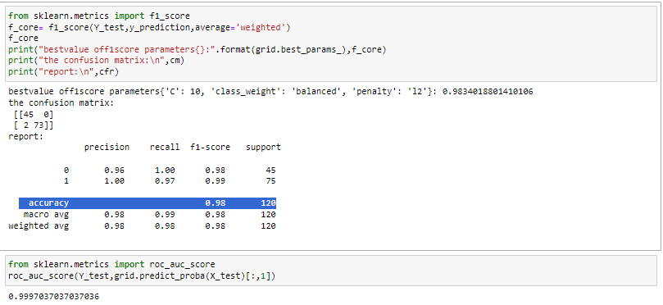
LOGISTIC C

Slide 10
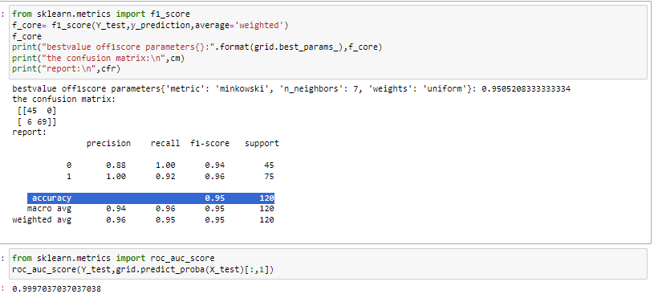
KNN

Slide 11
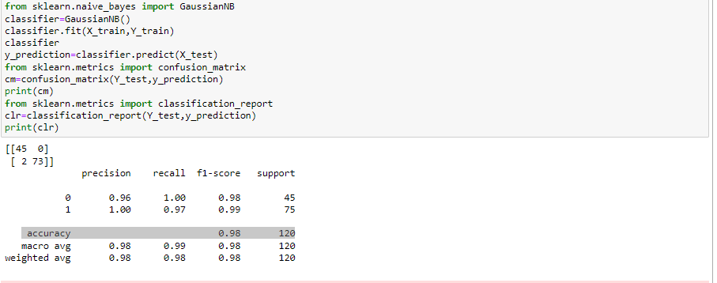
NVBAYES

Slide 13
6.) Mention your final model, justify why u have chosen the same.
Random Forest clssification is giving best accuracy value better then others ,so I choosed this AI brain for the CKD PREDICTION

